Slide 1
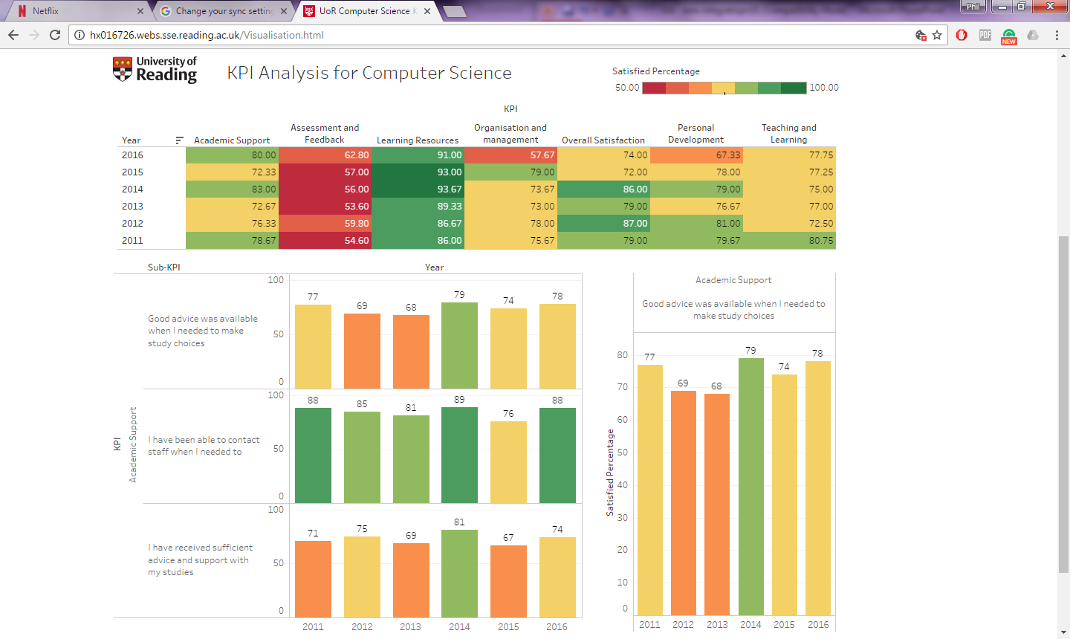
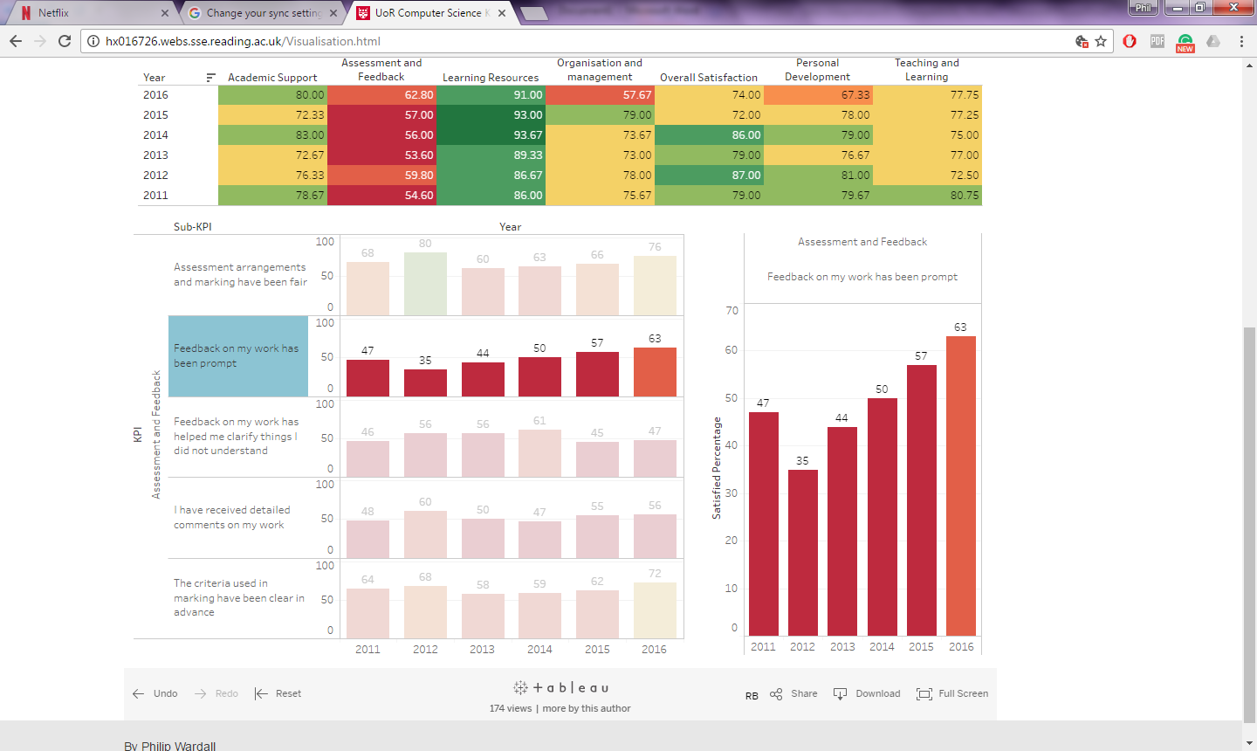
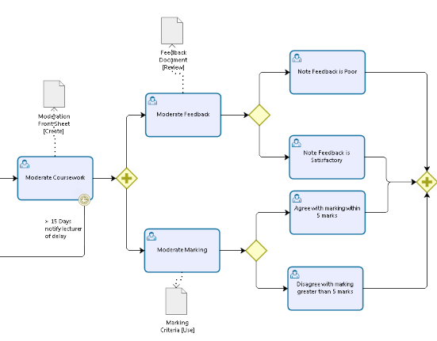
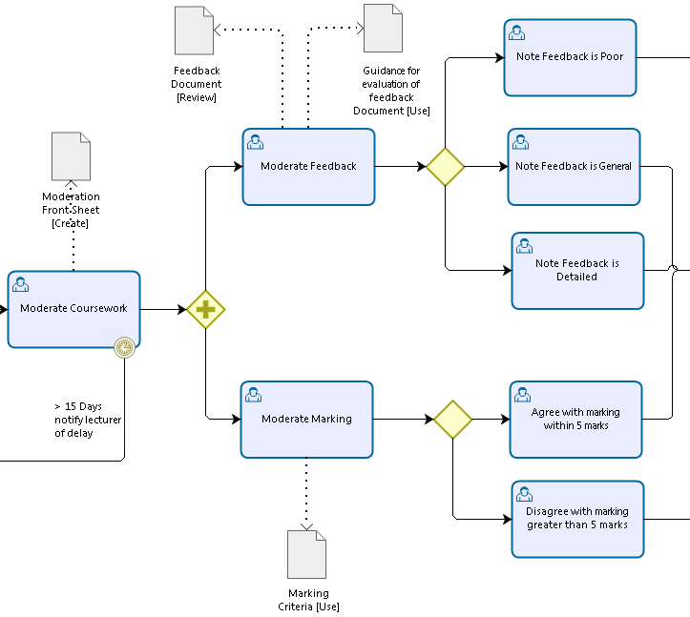
Data Analytics and Visualisation for Performance of Service Provision
Introduction
The aim of this project is to create a robust methodology that will enable universities to monitor the performance of their Teaching and Learning Key Performance Indicators (KPIs). Using data analytics and data visualisation universities will be able to identify which services are performing well and which are in need of review, thus which processes underpinning these services are successful and which need to be amended in order to seek continuous improvement of service provision.
The methodology will be piloted with the University of Reading’s Computer Science Department to Identify which KPI scores have increased or decreased in Certain Teaching and Learning areas and the processes behind the increase or decrease.
Methodology
NSS Data Collection
Using the National Student Survey (NSS) datasets, provided by the Higher Education Funding Council for Education (HEFCE) [1], universities can select the data they require for the analysis, selecting the desired course or courses they wish to assess.
Processing Data
In this processing stage, Extract Transform Load (ETL) is used to Extract the relevant course data, clean the data to remove errors and potential duplicates, Transform the data using a variety of calculation and enrichment functions and finally load the data into the target source.
Derive KPI
During the Transformation stage the data will be aggregated so as to identify the necessary Key Performance Indicators for measuring service provision.
Perform Data Analytics and Visualisation
With the necessary KPIs in place, the universities can use data analytics and visualisation to identify areas of strength and weakness as well as to incorporate the processes behind these areas.
Process Analysis
Once an area of interest has been located, process analysis can take place assessing the processes underpinning the KPI scores; allowing universities to understand which processes are successful and which are in need of review.
Implementation
The Methodology was implemented using three prominent technologies these included ETL, Tableau and BPMN 2.0. Tableau provided a collaborative environment, in which data analytics, data visualisation and process flow diagrams could be integrated through a fully interactive dashboard. The process flows, made in Bizagi Modeller, were embedded at the lowest level of granularity encouraging the user to drill down through the different hierarchies in the Dashboard.
Results
The fully interactive and integrated visualisation tool can be used to map the evolution of the performance of service provision. As outlined both data visualisation and process modelling allow universities to see how the results of process changes, are reflected in the increase or decrease of Teaching and Learning KPIs.
2015
2016
References
HEFCE, 2017. National Student Survey. [Online]
Available at: http://www.hefce.ac.uk/lt/nss/faq/
Degree programme
BSc Information Technology

